Slide 1
Induction for new Academic staff By Ag.Directorate of Academic Quality Assurance November 26th , 2024
RWANDA POLYTECHNIC
MUSANZE College

Slide 2
Introduction
This induction serves as a crucial bridge between the initial stages of employment and full integration in academic area, it helps:
Understanding your Roles and Responsibilities
Familiarization with the system you are working in
Enhanced Productivity and Performance
Improved Job Performance
Positive First Impressions
Alignment with Institutional Goals and Values

Slide 3
Types of assessment
In CBT/A system we have two main types of assessments:
1)Formative Assessments( formative assessments,Quizzes, assignments, presentations, CAT,…)
2)Summative/Integrated Situation.
For a student to sit for summative assessment/ Integrated Situation.
He/she should have 50% in F.A and 80% of class attendance

Slide 4
ASSESSMENT PREPARATION
The Formative and summative assessments should be set from simple to complex and includes all 3 domains of learning such as :
Cognitive domain: focuses on intellectual skills like critical thinking, problem-solving, and knowledge acquisition
Affective Domain: deals with emotions, feelings, attitudes, and values
Psychomotor Domain: focuses on practical skills

Slide 5
ASSESSMENT PREPARATION
While preparing these assessments, closed questions( True or false, multiple choices, table completion and matching questions) must not exceed 5 marks, to allow students to develop their levels of thinking and creativity

Slide 6
ASSESSMENT ADMINISTRATION
In RP-Musanze College,
The examinations are conducted on Tuesdays and Thursdays of every week.
The examination that are conducted on Tuesday and Thursday all must be registered on a timetable not later than Wednesday of previous week as per Article111from RP student Handbook.
The examinations that are conducted on Tuesday should be moderated and submitted in Academic Quality Office and Examination Office not later than the Friday of the previous week.

Slide 7
ASSESSMENT ADMINISTRATION
The examinations that are conducted on Thursday should be moderated and submitted in Academic Quality Office and Examination Office not later than Tuesday of that very week.

Slide 8
ASSESSMENT ADMINISTRATION
The Academic Services and academic quality assurance offices monitor the practices during the whole process.
The examinations and booklets will be collected from the examination office only once all planned invigilators are ready in the place.
Absenteeism of Invigilator must be notified to the HoD before the due date of examination for the replacement arrangements.
All invigilators must be attentive in invigilation rooms and do not give the students a chance to cheat, Students must checked before entering the examination rooms

Slide 9
ASSESSMENT ADMINISTRATION
No trainer is allowed to subtract the students marks for looking around during the exams, instead the trainer can change his/her sitting place
Once a student wants a permission during the exams, one invigilator should accompany the student
No student is allowed to enter the examination room after it has started

Slide 10
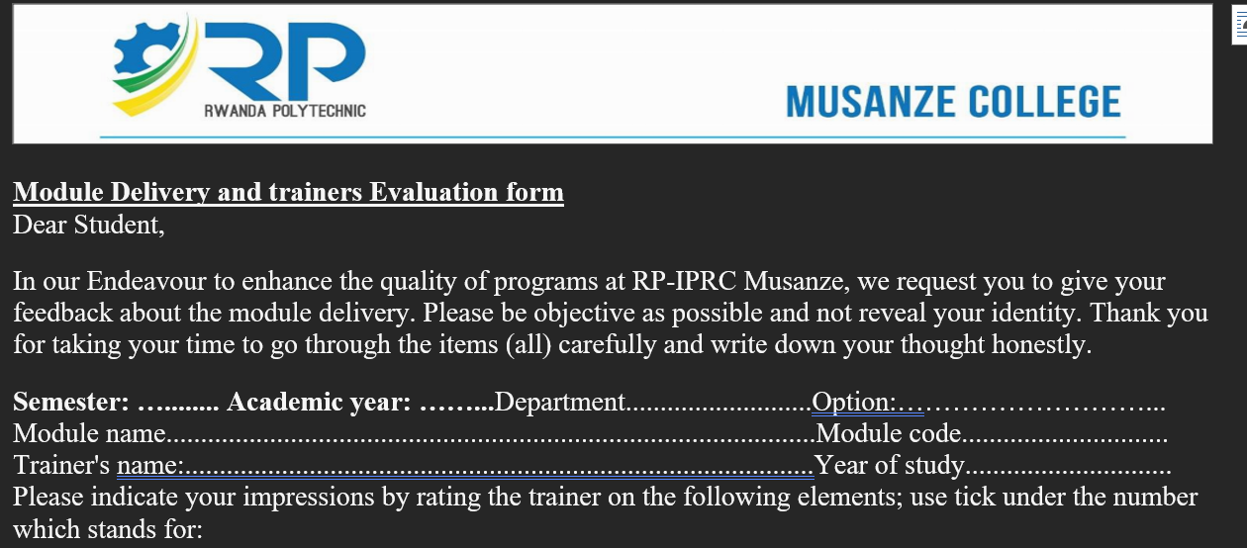
Trainers evaluation by students

Slide 11
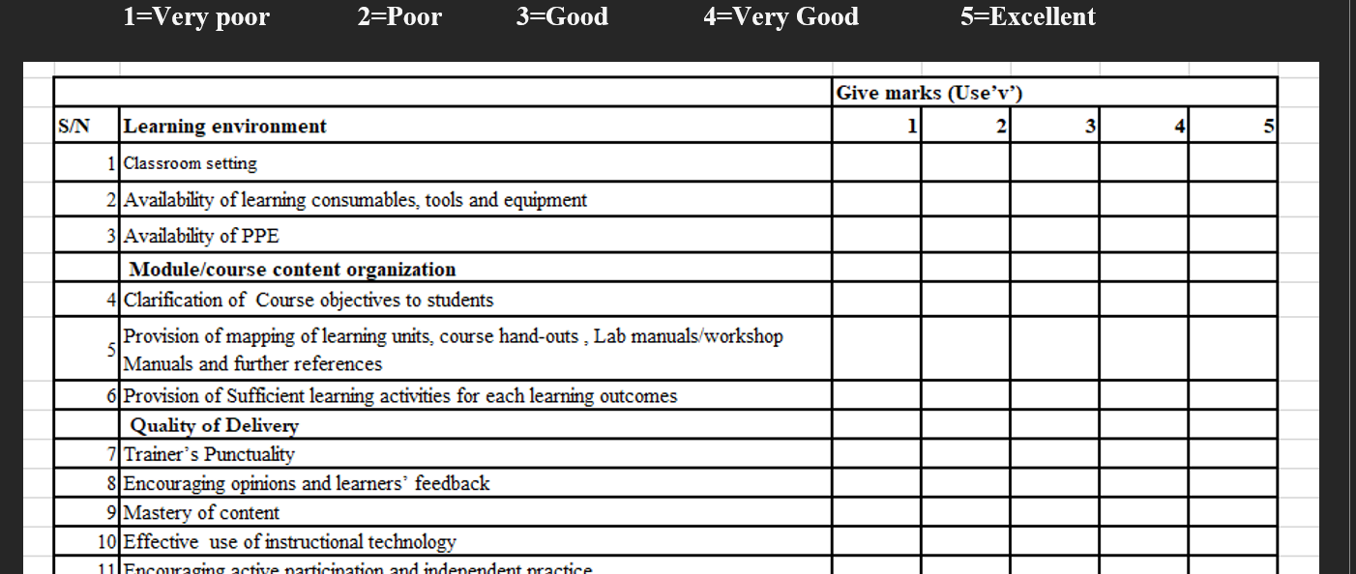
Trainers evaluation by students

Slide 12
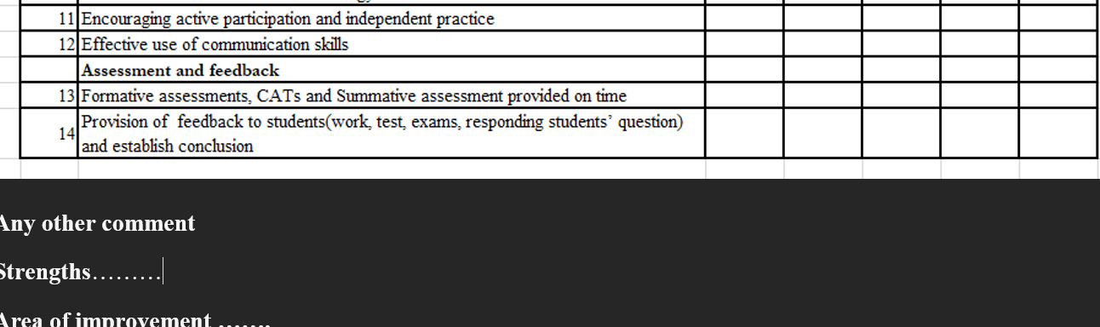
Trainers evaluation by students

